Slide 1

Interface
By Min Thet Naing

Slide 2
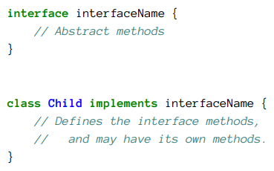
Creating Interface
By Min Thet Naing

Slide 3
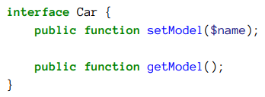
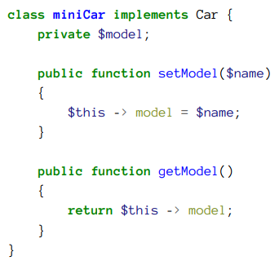
By Min Thet Naing

Slide 4
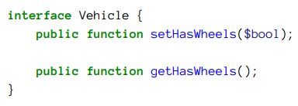
We can implement more than one interface in the same class
By Min Thet Naing

Slide 5
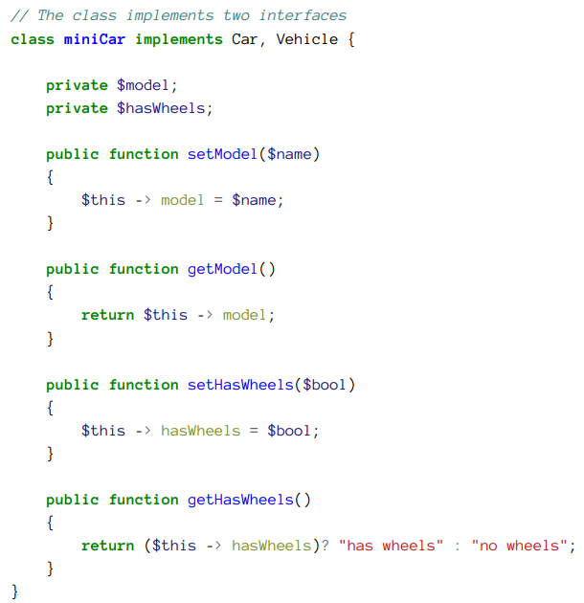
By Min Thet Naing

Slide 6
Differences Between abstract classes and interfaces
By Min Thet Naing

Slide 7
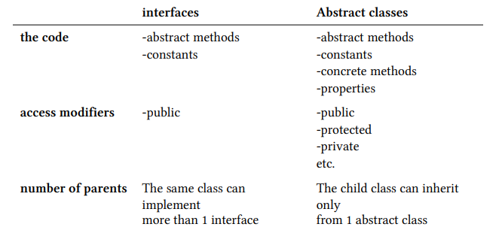
By Min Thet Naing

